Slide 1


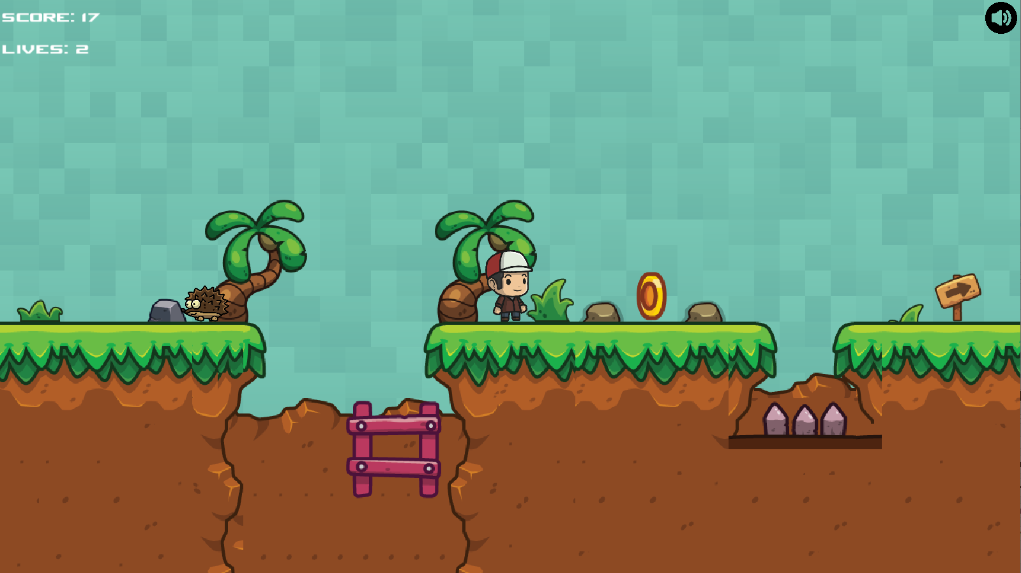
Recreate a classic arcade game
Bartosz Markiewicz Supervisor: Dr Faiyaz Doctor
What?
My project goals have been to create a side-scrolling 2D Mario game with lite RPG-elements such as friendly NPCs, a text based story narrative and a basic inventory system. My focus has been on having a working game with collisions, enemy AI agents and other dynamic world features such as unlockable doors and later trading/store mechanic.
Technical Achievements
I had created the game using a game development framework for Java based on OpenGL called libGDX which allowed me to create the game loop and world and have it work on Android and Windows with minimal platform-specific code.
All moving objects/sprites are animated using my own animation code
Works on Windows and Android
Easy level creation using TMX tiled maps.
Dynamic objects
Collisions
Friendly NPCs with interactions such as dialogue
Collectibles
Power-ups
Coins
Keys (for unlocking doors)
Different types of Enemy AI agents
Unlockable doors
Basic inventory system
Works on Windows and Android
Wide range of texture assets, sprites, sound effects employed.
Lastly I had built the game in a scalable way as to make adding additional content and game mechanics easy. For example to create a new Enemy type you simply extend Enemy abstract class, overriding its methods, then you place the new enemy on the TMX map of a level using a TMX file editor then you edit placeObjects() method in the GameScreen class so the new TMX map object is parsed and placed correctly using your new Java enemy class.
Why?
When I was younger I enjoyed platformers such as Donkey Kong and Mario. Although my issue with these games was that they were too basic and were missing something. This had influenced me to to recreate the classic side-scrolling Super Mario Bros experience with my own twist on the formula. My game will take a more complex and a different design approach. Furthermore despite the Mobile market being perfect for a casual side-scrolling platforming game there aren’t many such games. This made me choose to release the game on Android and Windows both.
Aims
To create a fun experience.
To release the game on the Android app store.

